Slide 1
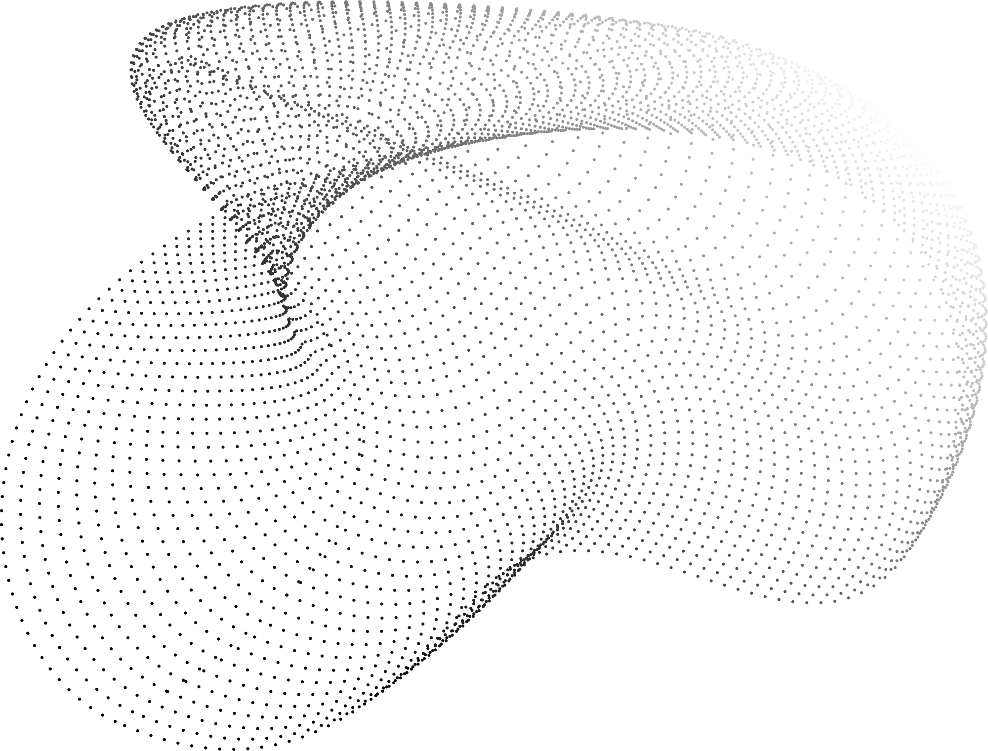

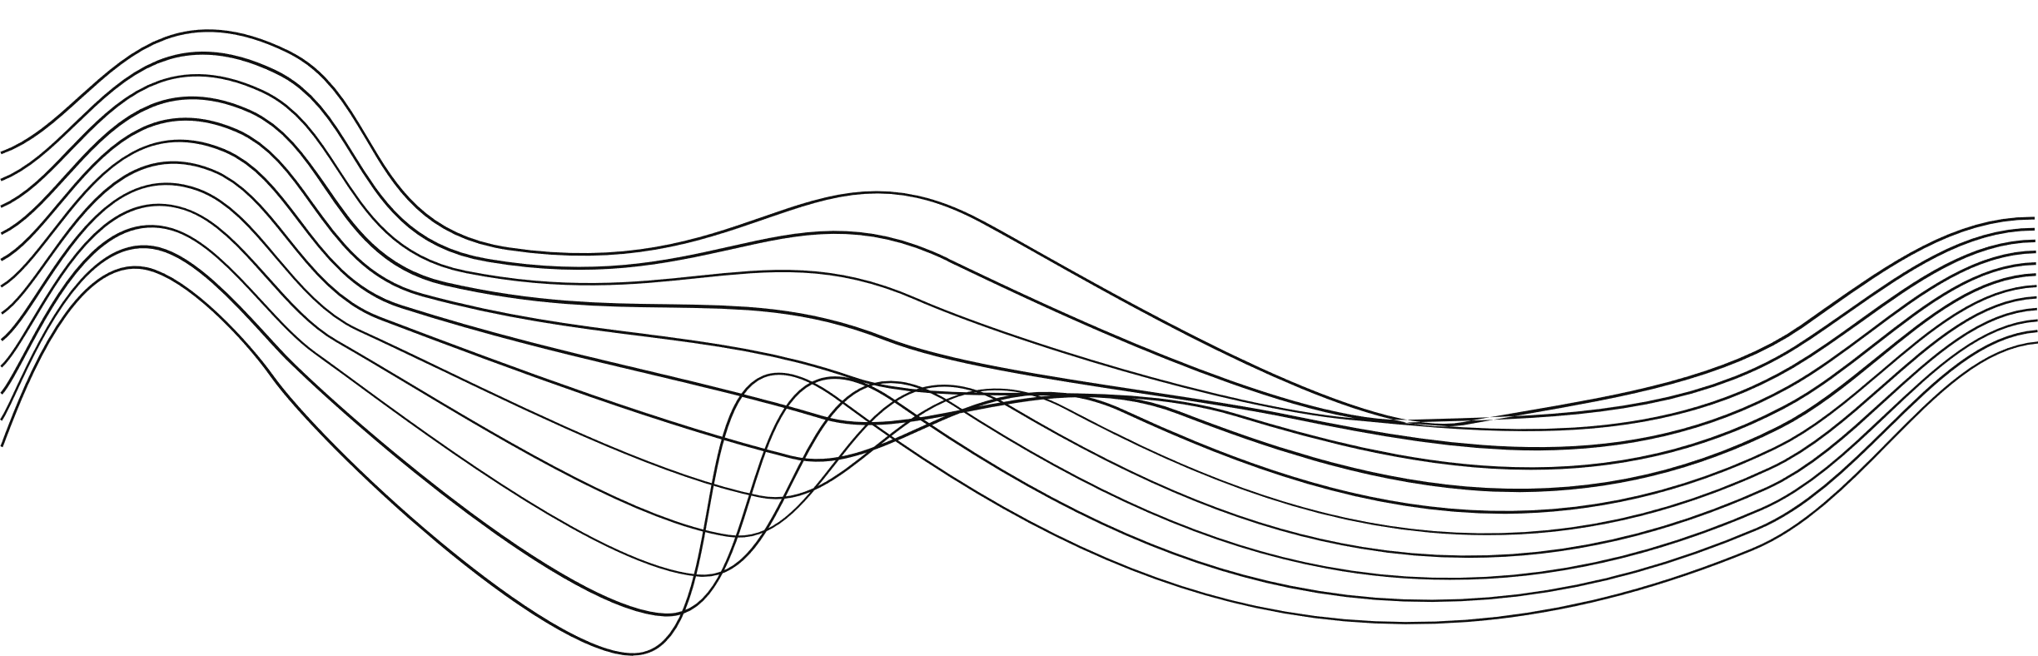
Presented By
Grusha bhattarai
INTERNET OF THINGS (IOT) WITH CLOUD COMPUTING
University of West of England

Slide 2
INTRODUCTION
WHAT IS IOT?
THREE LAYER OF IOT ARCHITECTURE
WHAT IS CLOUD COMPUTING
CHARACTERISTICS OF CLOUD COMPUTING
FUSION OF IOT AND CLOUD TECHNOLOGY
TABLE OF CONTENTS
RELATED WORK
CONCLUSIONS

Slide 3
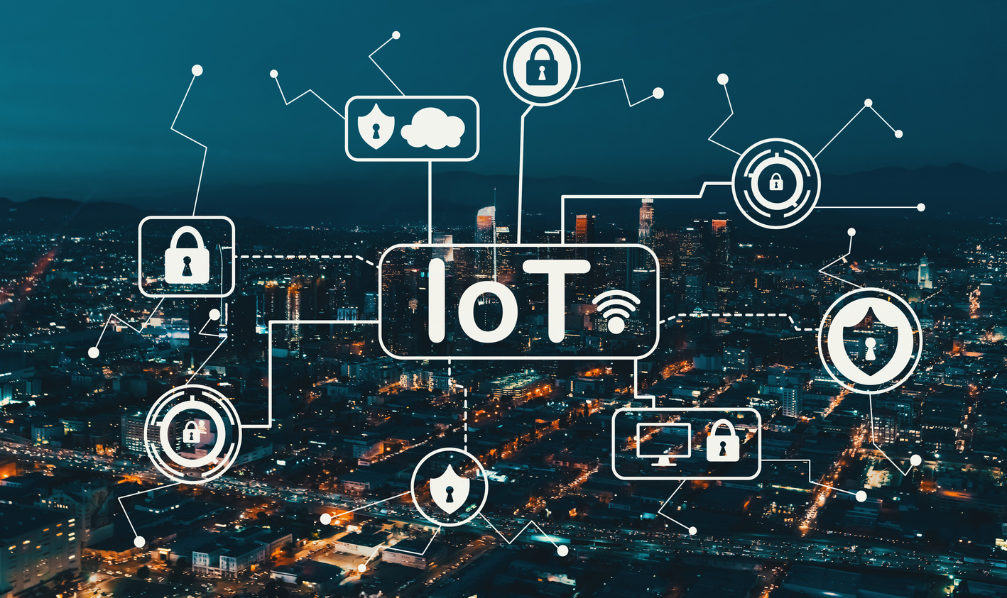
INTRODUCTION
A new era of data management and communication has been brought about by the convergence of two breakthrough technologies in recent years: cloud computing and the Internet of Things (IoT). This paradigm change has created a wealth of potential for efficiency and creativity in addition to changing the way we view and use technology.

Slide 4
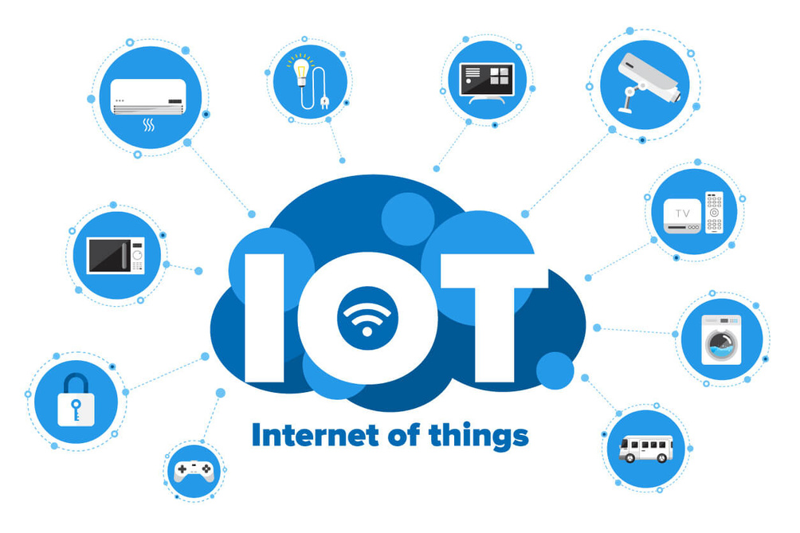
INTERNET OF THINGS
The Internet of Things (IoT) describes the network of physical objects—“things”—that are embedded with sensors, software, and other technologies for the purpose of connecting and exchanging data with other devices and systems over the internet.

Slide 5

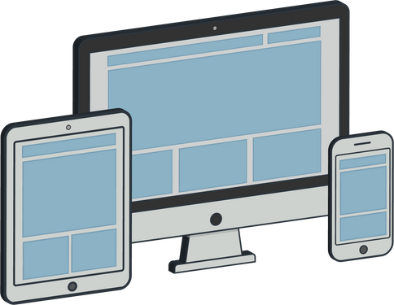
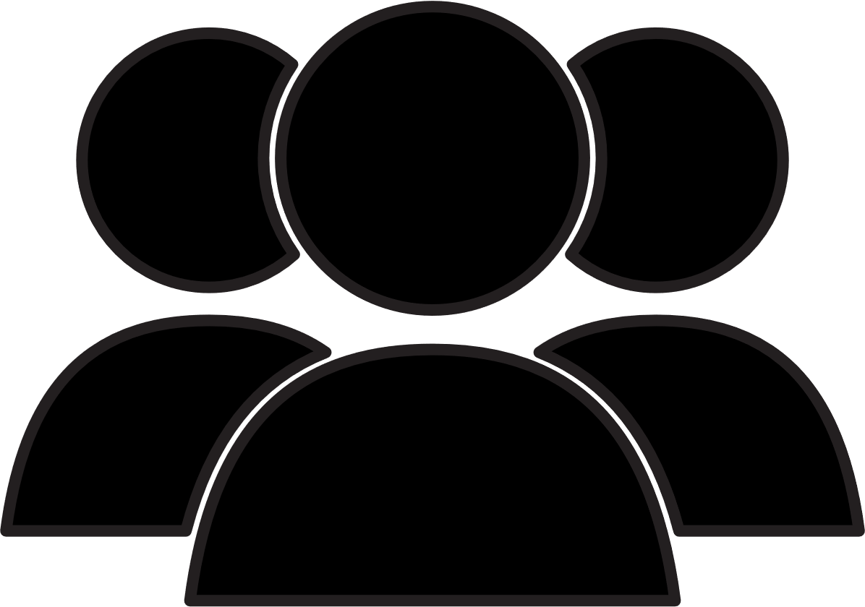


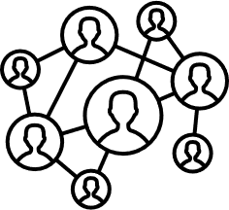
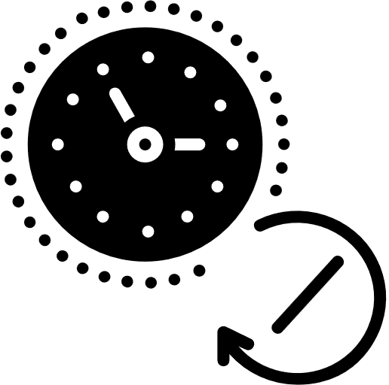
INTERNET OF THINGS
Any Device
Anybody
Anywhere
Any Business
Any Network
Anytime

Slide 6

INTERNET OF THINGS
30 Billion +
IoT devices active in 2020

Slide 7


INTERNET OF THINGS
30 Billion +
> Double
IoT devices active in 2020
growth of IoT devices in next 5 years

Slide 8

INTERNET OF THINGS
30 Billion +
> Double
$ 1 Tn +
IoT devices active in 2020
growth of IoT devices in next 5 years
Total TAM of IoT by 2025

Slide 9
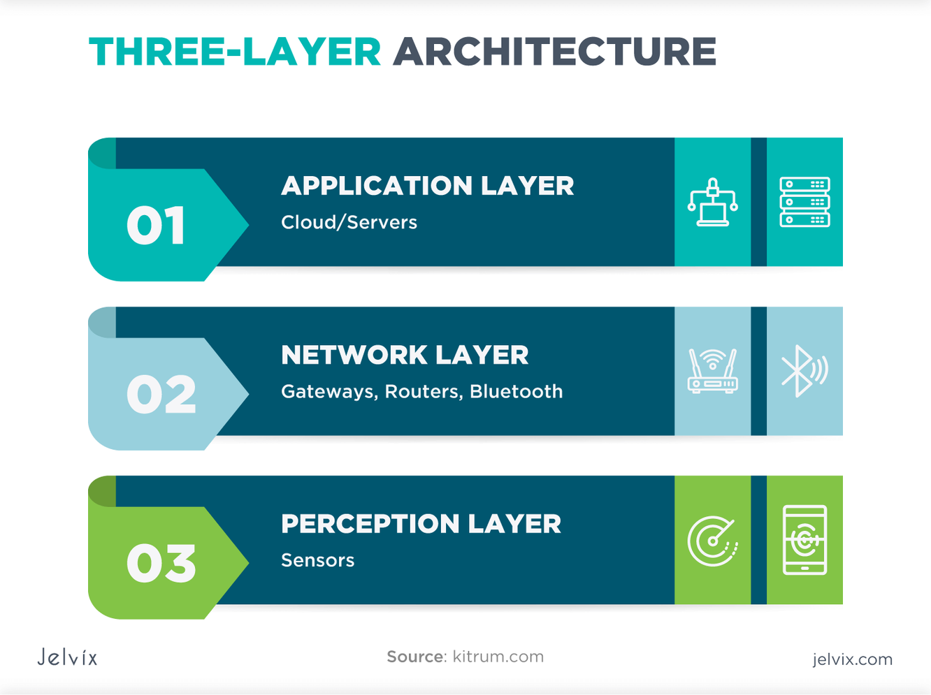
THREE LAYERS OF IOT ARCHITECTURE

Slide 10
THREE LAYERS OF IOT ARCHITECTURE
This layer acts as a bridge between the physical and digital realms. perception layer implies all type of sensors that can be used in iot device namely

Slide 11

THREE LAYERS OF IOT ARCHITECTURE
TEMPERATURE SENSORS

Slide 12
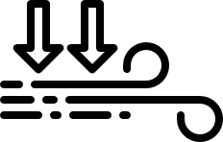
THREE LAYERS OF IOT ARCHITECTURE
TEMPERATURE SENSORS
PRESSURE
SENSORS

Slide 13

THREE LAYERS OF IOT ARCHITECTURE
TEMPERATURE SENSORS
PRESSURE SENSORS
LEVEL
SENSORS

Slide 14
THREE LAYERS OF IOT ARCHITECTURE
network layer helps to establish logical design of iot by connecting devices with the platform among the most popular iot communications models are

Slide 15

THREE LAYERS OF IOT ARCHITECTURE
WIFI

Slide 16

THREE LAYERS OF IOT ARCHITECTURE
WIFI
ETHERNET

Slide 17

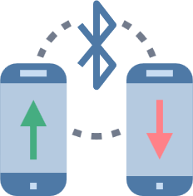
THREE LAYERS OF IOT ARCHITECTURE
WIFI
ETHERNET
BLUETOOTH

Slide 18
THREE LAYERS OF IOT ARCHITECTURE
This layer is the brain of the IoT architecture. Here, collected data is analyzed, leading to valuable insights and informed decision-making.

Slide 19

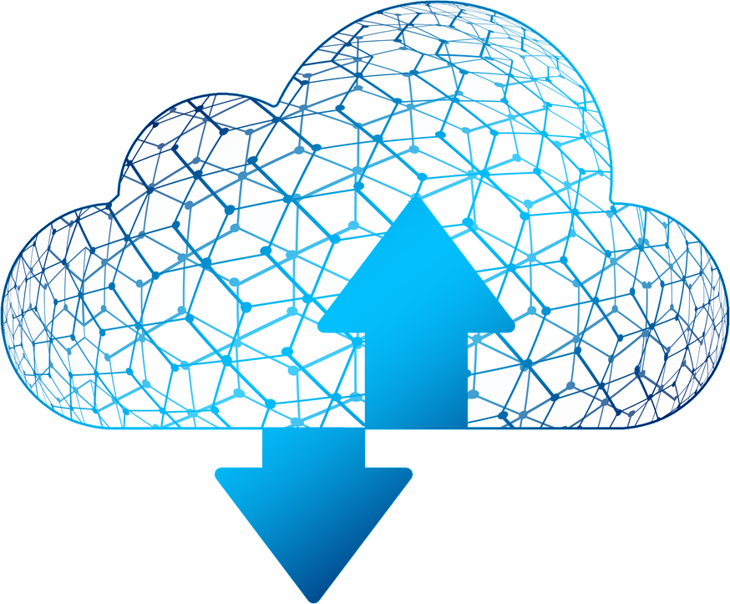
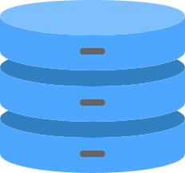
THREE LAYERS OF IOT ARCHITECTURE
Cloud computing resources are used extensively in this layer for complex computations, storing and processing large datasets, and deploying advanced algorithms that contribute to the automation and optimization of various processes.

Slide 20
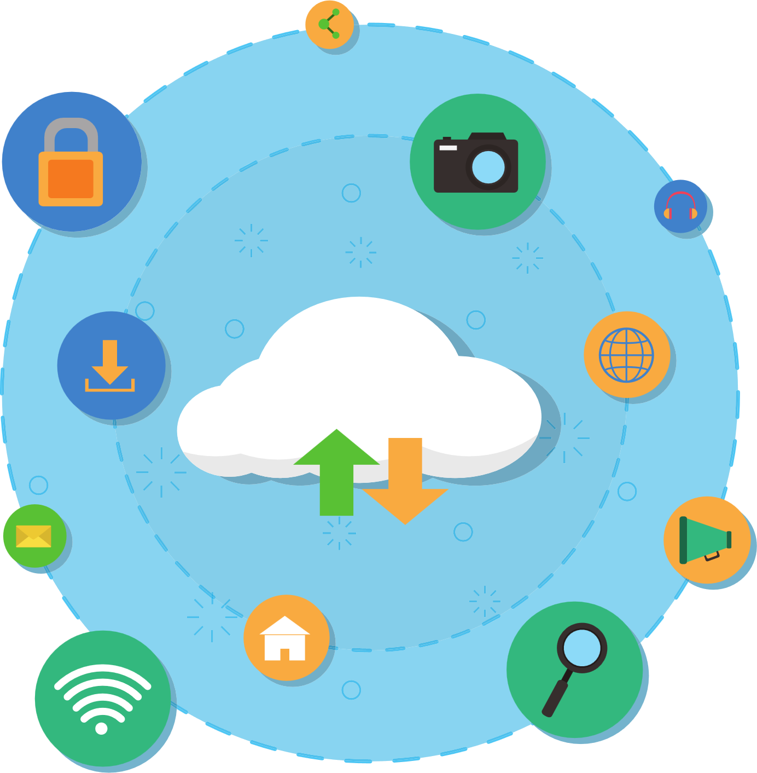
CLOUD COMPUTING
Cloud Computing is the delivery of on -demand resources (such as server, database, software, etc) over the internet.

Slide 21




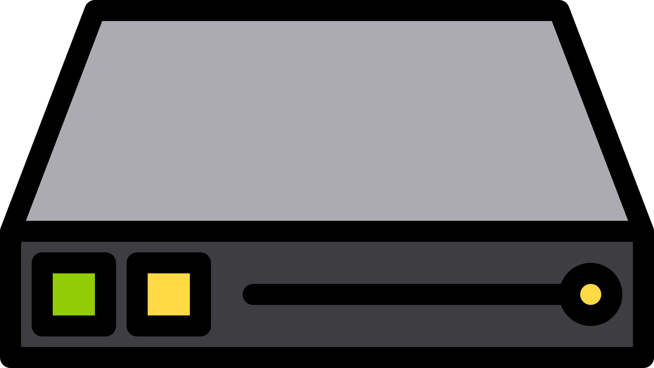

CLOUD COMPUTING
Rather than managing files on a local storage device, cloud computing makes it possible to save them over internet
STORAGE DEVICE
SAVE FILES

Slide 22
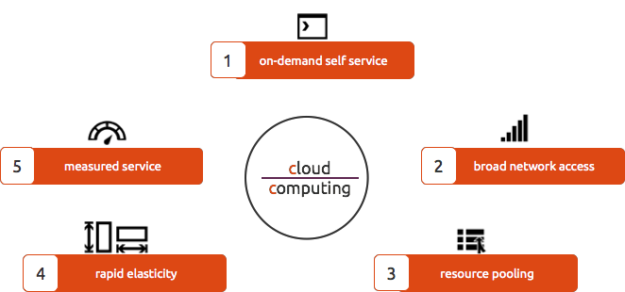
PRIMARY CHARACTERISTICS OF CLOUD COMPUTING

Slide 23

PRIMARY CHARACTERISTICS OF CLOUD COMPUTING
This cloud type lets users easily use and adjust computer resources. IoT systems benefit from its scalability, adapting to workload changes without big upfront investments in infrastructure.

Slide 24
PRIMARY CHARACTERISTICS OF CLOUD COMPUTING
This cloud type lets users easily use and adjust computer resources. IoT systems benefit from its scalability, adapting to workload changes without big upfront investments in infrastructure.
Various devices like laptops, phones, and IoT sensors can easily connect to cloud services over the internet, enhancing connectivity for real-time data transfer and collaboration.

Slide 25
PRIMARY CHARACTERISTICS OF CLOUD COMPUTING
This cloud type lets users easily use and adjust computer resources. IoT systems benefit from its scalability, adapting to workload changes without big upfront investments in infrastructure.
Various devices like laptops, phones, and IoT sensors can easily connect to cloud services over the internet, enhancing connectivity for real-time data transfer and collaboration.
Cloud platforms monitor and measure resource use, ensuring accountability. This promotes cost-effective management for IoT users, who pay for the resources they use.

Slide 26
PRIMARY CHARACTERISTICS OF CLOUD COMPUTING
Cloud resources can easily change based on demand. This quick adjustment ensures that the infrastructure adapts smoothly to changes in IoT data, maintaining a responsive and efficient system.

Slide 27

PRIMARY CHARACTERISTICS OF CLOUD COMPUTING
Cloud resources can easily change based on demand. This quick adjustment ensures that the infrastructure adapts smoothly to changes in IoT data, maintaining a responsive and efficient system.
Cloud companies boost efficiency by sharing resources among users, Because it enables devices to dynamically access shared resources, a big advantage for IoT that improves system performance.

Slide 28

INTEGRATION OF IOT AND CLOUD COMPUTING:
1
2
Resource Enhancement:
Cost Optimization:
IoT devices often have limited processing power and storage capacity. Cloud computing addresses this limitation by providing virtually unlimited resources on-demand.
Cloud resources follow a pay-as-you-go model, allowing organizations to optimize costs based on actual usage.
3
4
Data Collection Hub:
Remote Management and Control:
Cloud platforms act as a centralized hub for collecting data from diverse IoT devices spread across different locations.
Cloud-based management tools enable administrators to remotely monitor and control IoT devices.

Slide 29



REAL WORLD EXAMPLES
Smart Home Automation
Amazon's Alexa and Google Home use IoT devices with cloud integration for smart home automation, allowing users to control and monitor devices through voice commands.
Healthcare Monitoring
Fitbit, a company now part of Google, integrates IoT devices with cloud platforms for fitness tracking and health monitoring.
Industrial IoT
General Electric (GE) utilizes IoT and cloud computing for its Predix platform, offering industrial solutions for monitoring and optimizing machinery performance.

Slide 30
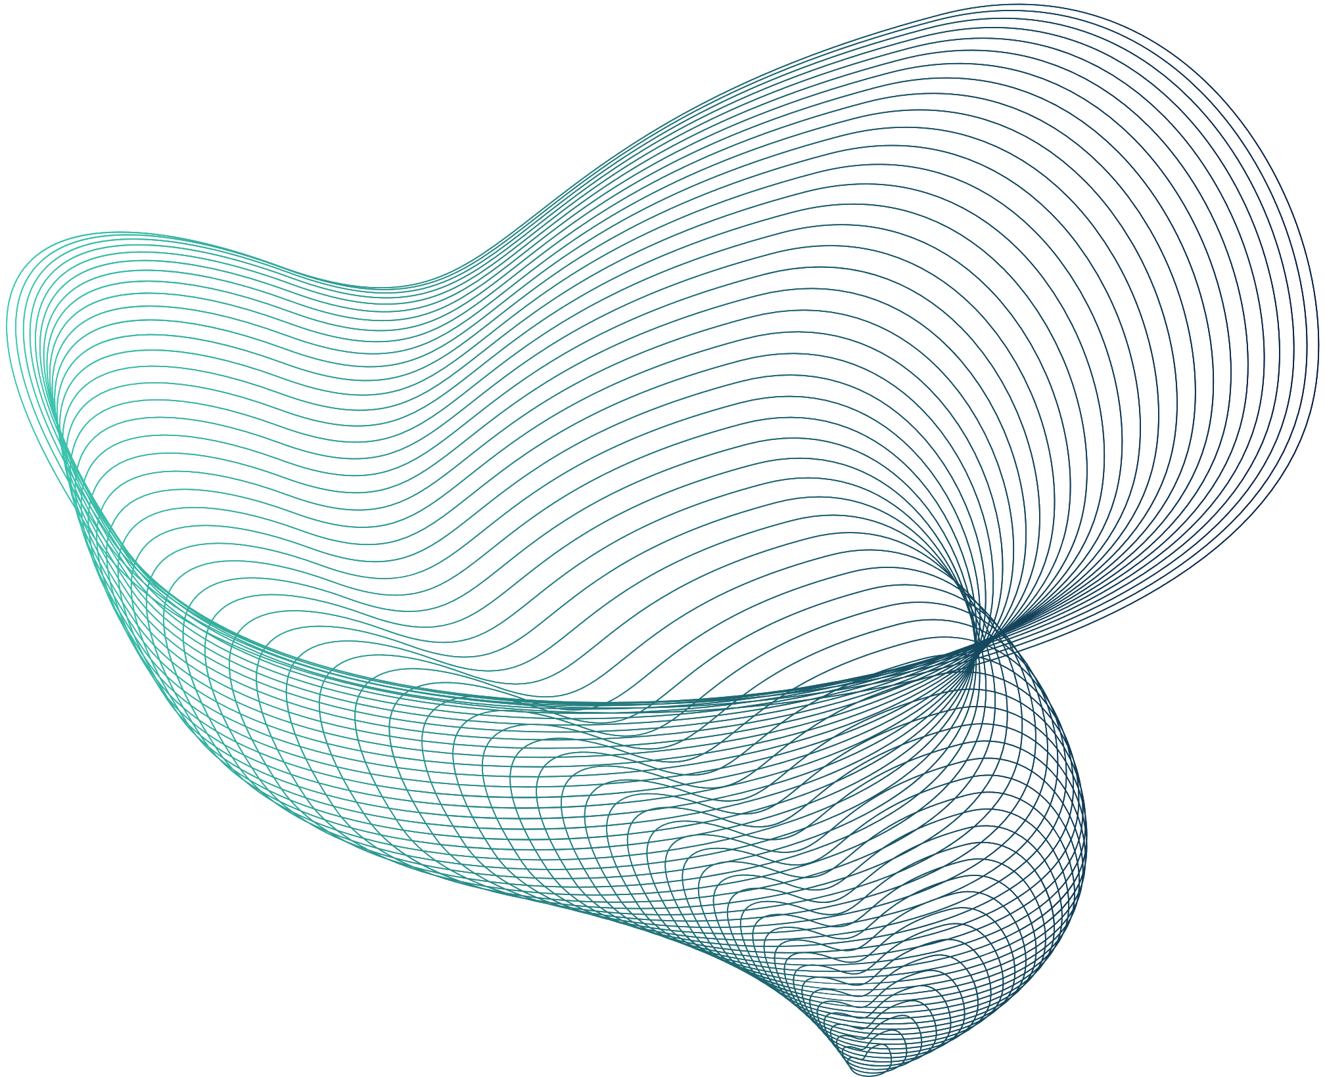
Conclusion
In conclusion, connecting gadgets to the internet and cloud systems is increasingly important as more devices emerge. Despite the usefulness, there are current issues with tools and manual efforts leading to mistakes. Our study explores the existing landscape using a special approach, revealing both positive and negative aspects. As technology advances, especially with edge computing, Big Data, blockchain, industrial 5.0, 5G, and AI, there are promising opportunities for businesses and researchers. The future looks bright, anticipating more connected gadgets and apps, enhancing data collection, improving operations, and creating opportunities in the field.

Slide 31
THANKYOU!

